Slide 1
UMass Lowell Computer Science 91.404
Analysis of Algorithms
Prof. Karen Daniels
Spring, 2008
Chapter 22: Graph Algorithms
Chapter 23: Minimum Spanning Trees
Chapter 24: Shortest Paths
[Source: Cormen et al. textbook except where noted]

Slide 2
Overview: Graph Algorithms
Chapter 22: Elementary Graph Algorithms
  Introductory Concepts
  Graph Traversals:
    Depth-First Search
    Breadth-First Search
  Topological Sort
Chapter 23: Minimum Spanning Trees
  Kruskal
  Prim
Chapter 24: Shortest Paths
  Dijkstra

Slide 3
Chapter 22
Graph Algorithms
Introductory Concepts
Depth-First Search Breadth-First Search
Topological Sort
[Source: Cormen et al. textbook except where noted]
Notes:
I joined the UMass Lowell Computer Science faculty this summer. This collection of slides is intended to familiarize the reader/viewer with my field of research (Computational Geometry), summarize my previous research results in this field and outline my plan for Computational Geometry research at UMass Lowell.

Slide 4
Introductory Graph Concepts
G= (V,E)
Vertex Degree
Self-Loops
Edges may have weights (see Chapters 23-24)
Undirected Graph
  No Self-Loops
  Adjacency is symmetric
Directed Graph (digraph)
  Degree: in/out
  Self-Loops allowed
A
B
A
B
C
C
D
F
D
E
F
E
This treatment follows 91.503 textbook Cormen et al. Some definitions differ slightly from other graph literature.

Slide 5

Introductory Graph Concepts:
Motivation
Networks are often modeled using graphs.

Slide 6
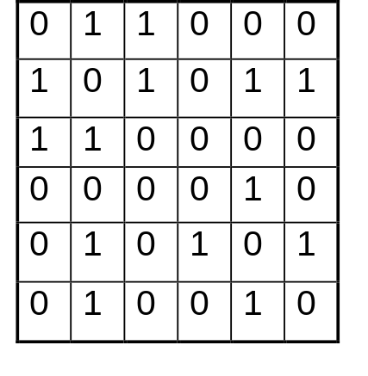
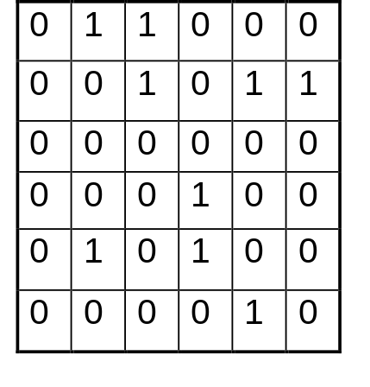
Introductory Graph Concepts:
Representations
Undirected Graph
Directed Graph (digraph)
A
B
A
B
C
C
D
E
F
D
E
F
A B C D E F
A B C D E F
A
B
C
D
E
F
A BC
B ACEF
C AB
D E
E BDF
F BE
A
B
C
D
E
F
A BC
B CEF
C
D D
E BD
F E
Adjacency Matrix
Adjacency List
Adjacency Matrix
Adjacency List
This treatment follows textbook Cormen et al. Some definitions differ slightly from other graph literature.

Slide 7
Introductory Graph Concepts:
Paths, Cycles
Path:
  length: number of edges
  simple: all vertices distinct
Cycle:
  Directed Graph:
    <v₀,v₁,...,v_{k} > forms cycle if v₀=v_{k} and k>=1
    simple cycle: v₁,v₂..,v_{k} also distinct
    self-loop is cycle of length 1
  Undirected Graph:
    <v₀,v₁,...,v_{k} > forms (simple) cycle if v₀=v_{k} and k>=3
    simple cycle: v₁,v₂..,v_{k} also distinct
A
B
path <A,B,F>
C
D
E
F
A
B
simple cycle <E,B,F,E>
C
D
E
F
simple cycle <A,B,C,A>= <B,C,A,B>
A
B
C
D
E
F
This treatment follows 91.503 textbook Cormen et al. Some definitions differ slightly from other graph literature.

Slide 8
Introductory Graph Concepts:
Connectivity
connected
A
B
C
Undirected Graph: connected
  every pair of vertices is connected by a path
  one connected component
  connected components:
    equivalence classes under “is reachable from” relation
Directed Graph: strongly connected
  every pair of vertices is reachable from each other
  one strongly connected component
  strongly connected components:
    equivalence classes under “mutually reachable” relation
D
F
E
A
B
C
2 connected components
D
E
F
A
B
not strongly connected
C
D
E
F
A
B
strongly connected component
C
D
E
F
This treatment follows 91.503 textbook Cormen et al. Some definitions differ slightly from other graph literature.

Slide 9
Depth-First Search (DFS)
&
Breadth-First Search (BFS)
Examples
Vertex Color Changes
Edge Classification
Using the Results of DFS & BFS Running Time Analysis

Slide 10
Depth-First Search (DFS)

Slide 11
Example:
DFS of Directed Graph
G=(V,E)
Adjacency List:
A: B,C,F
B: C,D
C: -
D: A,C
E: C,G
F: A,C
G: D,E
A
D
B
G
F
C
E
Edge Classification Legend:
T: tree edge
B: back edge
F: forward edge
C: cross edge
Source: Graph is from Computer Algorithms: Introduction to Design and Analysis by Baase and Gelder.

Slide 12
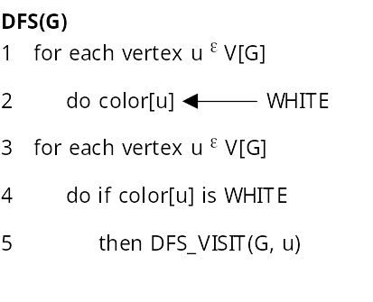
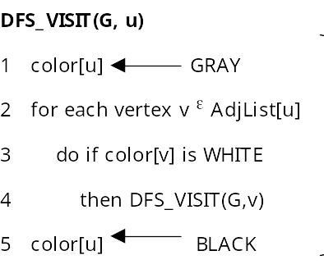
DFS PseudoCode
see web handout for full details

Slide 13
Vertex Color Changes
Vertex is WHITE if it has not yet been encountered during the search.
Vertex is GRAY if it has been encountered but has not yet been fully explored.
Vertex is BLACK if it has been fully explored.

Slide 14
Edge Classification
Each edge of the original graph G is classified during the search
  produces information needed to:
    build DFS or BFS spanning forest of trees
    detect cycles (DFS) or find shortest paths (BFS)
When vertex u is being explored, edge e = (u,v) is classified based on the color of v when the edge is first explored:
  e is a tree edge if v is WHITE [for DFS and BFS]
  e is a back edge if v is GRAY [for DFS only]
    for DFS this means v is an ancestor of u in the DFS tree
  e is a forward edge if v is BLACK and [for DFS only] v is a descendent of u in the DFS tree
  e is a cross edge if v is BLACK and [for DFS only] there is no ancestor or descendent relationship between u and v in the DFS tree
Note that:
  For BFS we’ll only consider tree edges.
  For DFS we consider all 4 edge types.
  In DFS of an undirected graph, every edge is either a tree edge or a back edge.

Slide 15
Example: (continued)
DFS of Directed Graph
Adjacency List:
A: B,C,F
B: C,D
C: -
D: A,C
E: C,G
F: A,C
G: D,E
A
D
B
G
F
C
E

Slide 16
Example: (continued)
DFS of Directed Graph
Adjacency List:
A: B,C,F
B: C,D
C: -
D: A,C
E: C,G
F: A,C
G: D,E
A
D
T
B
G
F
C
E

Slide 17
Example: (continued)
DFS of Directed Graph
Adjacency List:
A: B,C,F
B: C,D
C: -
D: A,C
E: C,G
F: A,C
G: D,E
A
D
T
B
G
F
C
E

Slide 18
Example: (continued)
DFS of Directed Graph
Adjacency List:
A: B,C,F
B: C,D
C: -
D: A,C
E: C,G
F: A,C
G: D,E
A
D
T
B
T
G
F
C
E

Slide 19
Example: (continued)
DFS of Directed Graph
Adjacency List:
A: B,C,F
B: C,D
C: -
D: A,C
E: C,G
F: A,C
G: D,E
A
D
T
B
T
G
F
C
E

Slide 20
Example: (continued)
DFS of Directed Graph
Adjacency List:
A: B,C,F
B: C,D
C: -
D: A,C
E: C,G
F: A,C
G: D,E
A
D
T
B
T
G
F
C
E

Slide 21
Example: (continued)
DFS of Directed Graph
Adjacency List:
A: B,C,F
B: C,D
C: -
D: A,C
E: C,G
F: A,C
G: D,E
A
D
T
T
B
T
G
F
C
E

Slide 22
Example: (continued)
DFS of Directed Graph
Adjacency List:
A: B,C,F
B: C,D
C: -
D: A,C
E: C,G
F: A,C
G: D,E
A
D
T
T
B
T
G
F
C
E

Slide 23
Example: (continued)
DFS of Directed Graph
Adjacency List:
A: B,C,F
B: C,D
C: -
D: A,C
E: C,G
F: A,C
G: D,E
B
A
D
T
T
B
T
G
F
C
E

Slide 24
Example: (continued)
DFS of Directed Graph
Adjacency List:
A: B,C,F
B: C,D
C: -
D: A,C
E: C,G
F: A,C
G: D,E
B
A
D
T
T
B
T
C
G
F
C
E

Slide 25
Example: (continued)
DFS of Directed Graph
Adjacency List:
A: B,C,F
B: C,D
C: -
D: A,C
E: C,G
F: A,C
G: D,E
B
A
D
T
T
B
T
C
G
F
C
E

Slide 26
Example: (continued)
DFS of Directed Graph
Adjacency List:
A: B,C,F
B: C,D
C: -
D: A,C
E: C,G
F: A,C
G: D,E
B
A
D
T
T
B
T
C
G
F
C
E

Slide 27
Example: (continued)
DFS of Directed Graph
Adjacency List:
A: B,C,F
B: C,D
C: -
D: A,C
E: C,G
F: A,C
G: D,E
B
A
D
T
T
B
F
T
C
G
F
C
E

Slide 28
Example: (continued)
DFS of Directed Graph
Adjacency List:
A: B,C,F
B: C,D
C: -
D: A,C
E: C,G
F: A,C
G: D,E
B
A
D
T
T
T
B
F
T
C
G
F
C
E

Slide 29
Example: (continued)
DFS of Directed Graph
Adjacency List:
A: B,C,F
B: C,D
C: -
D: A,C
E: C,G
F: A,C
G: D,E
B
A
D
T
T
T
B
F
T
C
G
F
C
E

Slide 30
Example: (continued)
DFS of Directed Graph
Adjacency List:
A: B,C,F
B: C,D
C: -
D: A,C
E: C,G
F: A,C
G: D,E
B
A
D
T
T
B
T
B
F
T
C
G
F
C
E

Slide 31
Example: (continued)
DFS of Directed Graph
Adjacency List:
A: B,C,F
B: C,D
C: -
D: A,C
E: C,G
F: A,C
G: D,E
B
A
D
T
T
B
T
B
F
T
C
G
F
C
E
C

Slide 32
Example: (continued)
DFS of Directed Graph
Adjacency List:
A: B,C,F
B: C,D
C: -
D: A,C
E: C,G
F: A,C
G: D,E
B
A
D
T
T
B
T
B
F
T
C
G
F
C
E
C

Slide 33
Example: (continued)
DFS of Directed Graph
Adjacency List:
A: B,C,F
B: C,D
C: -
D: A,C
E: C,G
F: A,C
G: D,E
B
A
D
T
T
B
T
B
F
T
C
G
F
C
E
C

Slide 34
Example: (continued)
DFS of Directed Graph
Adjacency List:
A: B,C,F
B: C,D
C: -
D: A,C
E: C,G
F: A,C
G: D,E
B
A
D
T
T
B
T
B
F
T
C
G
F
C
E
C

Slide 35
Example: (continued)
DFS of Directed Graph
Adjacency List:
A: B,C,F
B: C,D
C: -
D: A,C
E: C,G
F: A,C
G: D,E
B
A
D
T
T
B
T
B
F
T
C
G
F
C
C
E
C

Slide 36
Example: (continued)
DFS of Directed Graph
Adjacency List:
A: B,C,F
B: C,D
C: -
D: A,C
E: C,G
F: A,C
G: D,E
B
A
D
T
T
B
T
B
F
T
C
G
T
F
C
C
E
C

Slide 37
Example: (continued)
DFS of Directed Graph
Adjacency List:
A: B,C,F
B: C,D
C: -
D: A,C
E: C,G
F: A,C
G: D,E
B
A
D
T
T
B
T
B
F
T
C
G
T
F
C
C
E
C

Slide 38
Example: (continued)
DFS of Directed Graph
Adjacency List:
A: B,C,F
B: C,D
C: -
D: A,C
E: C,G
F: A,C
G: D,E
B
A
D
T
T
C
B
T
B
F
T
C
G
T
F
C
C
E
C

Slide 39
Example: (continued)
DFS of Directed Graph
Adjacency List:
A: B,C,F
B: C,D
C: -
D: A,C
E: C,G
F: A,C
G: D,E
B
A
D
T
T
C
B
T
B
F
T
C
G
T
B
F
C
C
E
C

Slide 40
Example: (continued)
DFS of Directed Graph
Adjacency List:
A: B,C,F
B: C,D
C: -
D: A,C
E: C,G
F: A,C
G: D,E
B
A
D
T
T
C
B
T
B
F
T
C
G
T
B
F
C
C
E
C

Slide 41
Example: (continued)
DFS of Directed Graph
Adjacency List:
A: B,C,F
B: C,D
C: -
D: A,C
E: C,G
F: A,C
G: D,E
B
A
D
T
T
C
B
T
B
F
T
C
G
T
B
F
C
C
E
C

Slide 42
Example: (continued)
DFS of Directed Graph
A
T
T
E
B
A
D
B
T
F
B
T
T
C
B
F
B
B
T
B
F
C
G
G
T
T
C
T
C
T
B
D
C
F
C
C
E
C
C
C
DFS
Tree 2
DFS Tree 1

Slide 43
Example:
DFS of Undirected Graph
G=(V,E)
Adjacency List:
A: B,C,D,F
B: A,C,D
C: A,B,D,E,F
D: A,B,C,G
E: C,G
F: A,C
G: D,E
A
D
B
G
F
C
E

Slide 44
Example:
DFS of Undirected Graph
Adjacency List:
A: B,C,D,F
B: A,C,D
C: A,B,D,E,F
D: A,B,C,G
E: C,G
F: A,C
G: D,E
A
D
B
G
F
C
E

Slide 45
Example:
DFS of Undirected Graph
Adjacency List:
A: B,C,D,F
B: A,C,D
C: A,B,D,E,F
D: A,B,C,G
E: C,G
F: A,C
G: D,E
A
D
T
B
G
F
C
E

Slide 46
Example:
DFS of Undirected Graph
Adjacency List:
A: B,C,D,F
B: A,C,D
C: A,B,D,E,F
D: A,B,C,G
E: C,G
F: A,C
G: D,E
A
D
T
B
G
F
C
E

Slide 47
Example:
DFS of Undirected Graph
Adjacency List:
A: B,C,D,F
B: A,C,D
C: A,B,D,E,F
D: A,B,C,G
E: C,G
F: A,C
G: D,E
A
D
T
B
T
G
F
C
E

Slide 48
Example:
DFS of Undirected Graph
Adjacency List:
A: B,C,D,F
B: A,C,D
C: A,B,D,E,F
D: A,B,C,G
E: C,G
F: A,C
G: D,E
A
D
T
B
T
G
F
C
E

Slide 49
Example:
DFS of Undirected Graph
Adjacency List:
A: B,C,D,F
B: A,C,D
C: A,B,D,E,F
D: A,B,C,G
E: C,G
F: A,C
G: D,E
A
D
T
B
B
T
G
F
C
E

Slide 50
Example:
DFS of Undirected Graph
Adjacency List:
A: B,C,D,F
B: A,C,D
C: A,B,D,E,F
D: A,B,C,G
E: C,G
F: A,C
G: D,E
A
D
T
B
T
G
B
T
F
C
E

Slide 51
Example:
DFS of Undirected Graph
Adjacency List:
A: B,C,D,F
B: A,C,D
C: A,B,D,E,F
D: A,B,C,G
E: C,G
F: A,C
G: D,E
A
D
T
B
T
G
B
T
F
C
E

Slide 52
Example:
DFS of Undirected Graph
B
Adjacency List:
A: B,C,D,F
B: A,C,D
C: A,B,D,E,F
D: A,B,C,G
E: C,G
F: A,C
G: D,E
A
D
T
B
T
G
B
T
F
C
E

Slide 53
Example:
DFS of Undirected Graph
B
Adjacency List:
A: B,C,D,F
B: A,C,D
C: A,B,D,E,F
D: A,B,C,G
E: C,G
F: A,C
G: D,E
A
D
T
B
B
T
G
B
T
F
C
E

Slide 54
Example:
DFS of Undirected Graph
B
Adjacency List:
A: B,C,D,F
B: A,C,D
C: A,B,D,E,F
D: A,B,C,G
E: C,G
F: A,C
G: D,E
A
D
T
B
T
B
T
G
B
T
F
C
E

Slide 55
Example:
DFS of Undirected Graph
B
Adjacency List:
A: B,C,D,F
B: A,C,D
C: A,B,D,E,F
D: A,B,C,G
E: C,G
F: A,C
G: D,E
A
D
T
B
T
B
T
G
B
T
F
C
E

Slide 56
Example:
DFS of Undirected Graph
B
Adjacency List:
A: B,C,D,F
B: A,C,D
C: A,B,D,E,F
D: A,B,C,G
E: C,G
F: A,C
G: D,E
A
D
T
B
T
B
T
G
B
T
T
F
C
E

Slide 57
Example:
DFS of Undirected Graph
B
Adjacency List:
A: B,C,D,F
B: A,C,D
C: A,B,D,E,F
D: A,B,C,G
E: C,G
F: A,C
G: D,E
A
D
T
B
T
B
T
G
B
T
T
F
C
E

Slide 58
Example:
DFS of Undirected Graph
B
Adjacency List:
A: B,C,D,F
B: A,C,D
C: A,B,D,E,F
D: A,B,C,G
E: C,G
F: A,C
G: D,E
A
D
T
B
T
B
T
G
B
T
T
B
F
C
E

Slide 59
Example:
DFS of Undirected Graph
B
Adjacency List:
A: B,C,D,F
B: A,C,D
C: A,B,D,E,F
D: A,B,C,G
E: C,G
F: A,C
G: D,E
A
D
T
B
T
B
T
G
B
T
T
B
F
C
E

Slide 60
Example:
DFS of Undirected Graph
B
Adjacency List:
A: B,C,D,F
B: A,C,D
C: A,B,D,E,F
D: A,B,C,G
E: C,G
F: A,C
G: D,E
A
D
T
B
T
B
T
G
B
T
T
B
F
C
E

Slide 61
Example:
DFS of Undirected Graph
B
Adjacency List:
A: B,C,D,F
B: A,C,D
C: A,B,D,E,F
D: A,B,C,G
E: C,G
F: A,C
G: D,E
A
D
T
B
T
B
T
G
B
T
T
B
F
C
E

Slide 62
Example:
DFS of Undirected Graph
B
Adjacency List:
A: B,C,D,F
B: A,C,D
C: A,B,D,E,F
D: A,B,C,G
E: C,G
F: A,C
G: D,E
A
D
T
B
T
B
T
G
B
T
T
T
B
F
C
E

Slide 63
Example:
DFS of Undirected Graph
B
Adjacency List:
A: B,C,D,F
B: A,C,D
C: A,B,D,E,F
D: A,B,C,G
E: C,G
F: A,C
G: D,E
A
D
T
B
T
B
T
G
B
T
T
T
B
F
C
E

Slide 64
Example:
DFS of Undirected Graph
B
Adjacency List:
A: B,C,D,F
B: A,C,D
C: A,B,D,E,F
D: A,B,C,G
E: C,G
F: A,C
G: D,E
A
D
T
B
T
B
B
T
G
B
T
T
T
B
F
C
E

Slide 65
Example:
DFS of Undirected Graph
B
Adjacency List:
A: B,C,D,F
B: A,C,D
C: A,B,D,E,F
D: A,B,C,G
E: C,G
F: A,C
G: D,E
A
D
T
B
T
B
B
T
G
B
T
T
T
B
F
C
E

Slide 66
Example:
DFS of Undirected Graph
B
Adjacency List:
A: B,C,D,F
B: A,C,D
C: A,B,D,E,F
D: A,B,C,G
E: C,G
F: A,C
G: D,E
A
D
T
B
T
B
B
T
G
B
T
T
T
B
F
C
E

Slide 67
Example:
DFS of Undirected Graph
B
Adjacency List:
A: B,C,D,F
B: A,C,D
C: A,B,D,E,F
D: A,B,C,G
E: C,G
F: A,C
G: D,E
A
D
T
B
T
B
B
T
G
B
T
T
T
B
F
C
E

Slide 68
Example:
DFS of Undirected Graph
B
Adjacency List:
A: B,C,D,F
B: A,C,D
C: A,B,D,E,F
D: A,B,C,G
E: C,G
F: A,C
G: D,E
A
D
T
B
T
B
B
T
G
B
T
T
T
B
F
C
E

Slide 69
Example: (continued)
DFS of Undirected Graph
A
T
B
B
B
T
B
B
A
D
B
T
B
T
C
T
T
B
B
T
G
B
T
D
F
T
T
T
B
F
C
E
B
G
T
E
DFS Tree

Slide 70
Elementary Graph Algorithms:
DFS
Review problem: TRUE or FALSE?
  The tree shown below on the right can be a DFS tree for some adjacency list representation of the graph shown below on the left.
A
A
B
Tree Edge
Back
Edge
C
Tree Edge
F
B
Tree Edge
E
Tree Edge
D
E
F
C
Cross Edge
Tree Edge
D

Slide 71
Breadth-First Search (BFS)

Slide 72
BFS PseudoCode
See handout on web

Slide 73
Example:
BFS of Directed Graph
G=(V,E)
Adjacency List:
A: B,C,F
B: C,D
C: -
D: A,C
E: C,G
F: A,C
G: D,E
A
D
B
G
F
C
E
Edge Classification Legend:
T: tree edge
only tree edges are used
Source: Graph is from Computer Algorithms: Introduction to Design and Analysis by Baase and Gelder.

Slide 74
Example:
BFS of Directed Graph
Adjacency List:
A: B,C,F
B: C,D
C: -
D: A,C
E: C,G
F: A,C
G: D,E
A
D
B
G
F
C
E
Queue: A

Slide 75
Example:
BFS of Directed Graph
Adjacency List:
A: B,C,F
B: C,D
C: -
D: A,C
E: C,G
F: A,C
G: D,E
A
D
T
B
G
F
C
E
Queue: AB

Slide 76
Example:
BFS of Directed Graph
Adjacency List:
A: B,C,F
B: C,D
C: -
D: A,C
E: C,G
F: A,C
G: D,E
A
D
T
B
T
G
F
C
E
Queue: ABC

Slide 77
Example:
BFS of Directed Graph
Adjacency List:
A: B,C,F
B: C,D
C: -
D: A,C
E: C,G
F: A,C
G: D,E
A
D
T
B
T
T
G
F
C
E
Queue: ABCF

Slide 78
Example:
BFS of Directed Graph
Adjacency List:
A: B,C,F
B: C,D
C: -
D: A,C
E: C,G
F: A,C
G: D,E
A
D
T
B
T
T
G
F
C
E
Queue: BCF

Slide 79
Example:
BFS of Directed Graph
Adjacency List:
A: B,C,F
B: C,D
C: -
D: A,C
E: C,G
F: A,C
G: D,E
A
D
T
T
B
T
T
G
F
C
E
Queue: BCFD

Slide 80
Example:
BFS of Directed Graph
Adjacency List:
A: B,C,F
B: C,D
C: -
D: A,C
E: C,G
F: A,C
G: D,E
A
D
T
T
B
T
T
G
F
C
E
Queue: CFD

Slide 81
Example:
BFS of Directed Graph
Adjacency List:
A: B,C,F
B: C,D
C: -
D: A,C
E: C,G
F: A,C
G: D,E
A
D
T
T
B
T
T
G
F
C
E
Queue: FD

Slide 82
Example:
BFS of Directed Graph
Adjacency List:
A: B,C,F
B: C,D
C: -
D: A,C
E: C,G
F: A,C
G: D,E
A
D
T
T
B
T
T
G
F
C
E
Queue: D

Slide 83
Example:
BFS of Directed Graph
Adjacency List:
A: B,C,F
B: C,D
C: -
D: A,C
E: C,G
F: A,C
G: D,E
A
D
T
T
B
T
T
G
F
C
E
Queue: -

Slide 84
Example:
BFS of Directed Graph
Adjacency List:
A: B,C,F
B: C,D
C: -
D: A,C
E: C,G
F: A,C
G: D,E
A
D
T
T
B
T
T
G
F
C
E
Queue: E

Slide 85
Example:
BFS of Directed Graph
Adjacency List:
A: B,C,F
B: C,D
C: -
D: A,C
E: C,G
F: A,C
G: D,E
A
D
T
T
B
T
T
G
T
F
C
E
Queue: EG

Slide 86
Example:
BFS of Directed Graph
Adjacency List:
A: B,C,F
B: C,D
C: -
D: A,C
E: C,G
F: A,C
G: D,E
A
D
T
T
B
T
T
G
T
F
C
E
Queue: G

Slide 87
Example:
BFS of Directed Graph
Adjacency List:
A: B,C,F
B: C,D
C: -
D: A,C
E: C,G
F: A,C
G: D,E
A
D
T
T
B
T
T
G
T
F
C
E
Queue: -

Slide 88
Example: (continued)
BFS of Directed Graph
A
E
T
T
T
A
D
T
T
T
B
C
F
G
B
T
T
G
T
Shortest path
distance from :
E to G = 1
T
D
Shortest path
distance from :
A to B = 1
A to C = 1
A to F = 1
A to D = 2
F
C
E
BFS
Tree 2
BFS Tree 1

Slide 89
Example:
BFS of Undirected Graph
G=(V,E)
Adjacency List:
A: B,C,D,F
B: A,C,D
C: A,B,D,E,F
D: A,B,C,G
E: C,G
F: A,C
G: D,E
A
D
B
G
F
C
E
Edge Classification Legend:
T: tree edge
only tree edges are used

Slide 90
Example:
BFS of Undirected Graph
Adjacency List:
A: B,C,D,F
B: A,C,D
C: A,B,D,E,F
D: A,B,C,G
E: C,G
F: A,C
G: D,E
A
D
B
G
F
C
E
Queue: A

Slide 91
Example:
BFS of Undirected Graph
Adjacency List:
A: B,C,D,F
B: A,C,D
C: A,B,D,E,F
D: A,B,C,G
E: C,G
F: A,C
G: D,E
A
D
T
B
G
F
C
E
Queue: AB

Slide 92
Example:
BFS of Undirected Graph
Adjacency List:
A: B,C,D,F
B: A,C,D
C: A,B,D,E,F
D: A,B,C,G
E: C,G
F: A,C
G: D,E
A
D
T
B
T
G
F
C
E
Queue: ABC

Slide 93
Example:
BFS of Undirected Graph
T
Adjacency List:
A: B,C,D,F
B: A,C,D
C: A,B,D,E,F
D: A,B,C,G
E: C,G
F: A,C
G: D,E
A
D
T
B
T
G
F
C
E
Queue: ABCD

Slide 94
Example:
BFS of Undirected Graph
T
Adjacency List:
A: B,C,D,F
B: A,C,D
C: A,B,D,E,F
D: A,B,C,G
E: C,G
F: A,C
G: D,E
A
D
T
T
B
T
G
F
C
E
Queue: ABCDF

Slide 95
Example:
BFS of Undirected Graph
T
Adjacency List:
A: B,C,D,F
B: A,C,D
C: A,B,D,E,F
D: A,B,C,G
E: C,G
F: A,C
G: D,E
A
D
T
T
B
T
G
F
C
E
Queue: BCDF

Slide 96
Example:
BFS of Undirected Graph
T
Adjacency List:
A: B,C,D,F
B: A,C,D
C: A,B,D,E,F
D: A,B,C,G
E: C,G
F: A,C
G: D,E
A
D
T
T
B
T
G
F
C
E
Queue: CDF

Slide 97
Example:
BFS of Undirected Graph
T
Adjacency List:
A: B,C,D,F
B: A,C,D
C: A,B,D,E,F
D: A,B,C,G
E: C,G
F: A,C
G: D,E
A
D
T
T
B
T
G
F
C
E
T
Queue: CDFE

Slide 98
Example:
BFS of Undirected Graph
T
Adjacency List:
A: B,C,D,F
B: A,C,D
C: A,B,D,E,F
D: A,B,C,G
E: C,G
F: A,C
G: D,E
A
D
T
T
B
T
G
F
C
E
T
Queue: DFE

Slide 99
Example:
BFS of Undirected Graph
T
Adjacency List:
A: B,C,D,F
B: A,C,D
C: A,B,D,E,F
D: A,B,C,G
E: C,G
F: A,C
G: D,E
A
D
T
T
T
B
T
G
F
C
E
T
Queue: DFEG

Slide 100
Example:
BFS of Undirected Graph
T
Adjacency List:
A: B,C,D,F
B: A,C,D
C: A,B,D,E,F
D: A,B,C,G
E: C,G
F: A,C
G: D,E
A
D
T
T
T
B
T
G
F
C
E
T
Queue: FEG

Slide 101
Example:
BFS of Undirected Graph
T
Adjacency List:
A: B,C,D,F
B: A,C,D
C: A,B,D,E,F
D: A,B,C,G
E: C,G
F: A,C
G: D,E
A
D
T
T
T
B
T
G
F
C
E
T
Queue: EG

Slide 102
Example:
BFS of Undirected Graph
T
Adjacency List:
A: B,C,D,F
B: A,C,D
C: A,B,D,E,F
D: A,B,C,G
E: C,G
F: A,C
G: D,E
A
D
T
T
T
B
T
G
F
C
E
T
Queue: G

Slide 103
Example:
BFS of Undirected Graph
T
Adjacency List:
A: B,C,D,F
B: A,C,D
C: A,B,D,E,F
D: A,B,C,G
E: C,G
F: A,C
G: D,E
A
D
T
T
T
B
T
G
F
C
E
T
Queue: -

Slide 104
Example: (continued)
BFS of Undirected Graph
A
T
T
T
T
T
A
D
T
T
D
F
B
C
T
B
T
T
T
G
E
G
F
C
E
T
Shortest path distance from :
A to B = 1 A to E = 2
A to C = 1 A to G = 2
A to D = 1
A to F = 1
BFS Tree

Slide 105
Depth-First Search (DFS)
&
Breadth-First Search (BFS)
Using the Results of DFS & BFS
Running Time Analysis

Slide 106
Using the Results of DFS & BFS
Using DFS to Detect Cycles:
Using BFS for Shortest Paths:
A directed graph G is acyclic if and only if a Depth-First Search of G yields no back edges.
see p. 550 of text for proof
Note: DFS can also be used to detect cycles in undirected graphs if notion of cycle is defined appropriately.
A Breadth-First Search of G yields shortest path information:
For each Breadth-First Search tree, the path from its root u to a vertex v yields the shortest path from u to v in G.
see p. 534-537 of text for proof

Slide 107
Elementary Graph Algorithms:
SEARCHING: DFS, BFS
  for unweighted directed or undirected graph G=(V,E)
Time: O(|V| + |E|) adj list O(|V|²) adj matrix
  predecessor subgraph = forest of spanning trees
Breadth-First-Search (BFS):
  Shortest Path Distance
    From source to each reachable vertex
    Record during traversal
  Foundation of many “shortest path” algorithms
Depth-First-Search (DFS):
  Encountering, finishing times
    “well-formed” nested (( )( ) ) structure
  DFS of undirected graph produces only back edges or tree edges
  Directed graph is acyclic if and only if DFS yields no back edges
  Vertex color shows status:
not yet encountered
encountered, but not yet finished
finished
See DFS, BFS Handout for PseudoCode

Slide 108
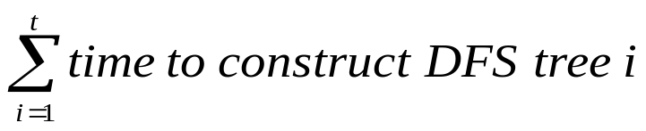
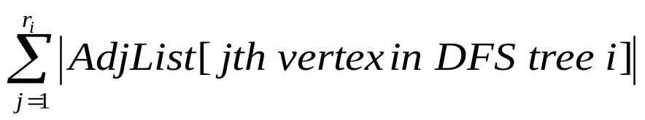
Running Time Analysis
Key ideas in the analysis are similar for DFS and BFS. In both cases we assume an Adjacency List representation. Let’s examine DFS.
Let t be number of DFS trees generated by DFS
Outer loop in DFS(G) executes t times
  each execution contains call: DFS_Visit(G,u)
  each such call constructs a DFS tree by visiting (recursively) every node reachable from vertex u
  Time:
Now, let r_{i} be the number of vertices in DFS tree i
Time to construct DFS tree i:
continued on next slide...

Slide 109
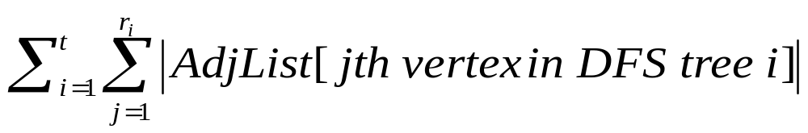

Running Time Analysis
Total DFS time:
Now, consider this expression for the extreme values of t:
  if t=1, all edges are in one DFS tree and the expression simplifies to O(|E|)
  if t=|V|, each vertex is its own (degenerate) DFS tree with no edges so the expression simplifies to O(|V|)
  O(|V|+|E|) is therefore an upper bound on the time for the extreme cases
For values of t in between 1 and |V| we have these contributions to running time:
    1 for each vertex that is its own (degenerate) DFS tree with no edges
      upper bound on this total is O(|V|)
    |AdjList[u]| for each vertex u that is a node of a non-degenerate DFS tree
      upper bound on this total is O(|E|)
    Total time for values of t in between 1 and |V| is therefore also O(|V|+|E|)
Total time=
Note that for an Adjacency Matrix representation, we would need to scan an entire matrix row (containing |V| entries) each time we examined the vertices adjacent to a vertex. This would make the running time O(|V|²) instead of O(|V|+|E|).

Slide 110
Topological Sort
Source: Previous 91.404 instructors

Slide 111
Definition: DAG
A Directed Acyclic Graph often abbreviated DAG
DAGs used in many applications to indicate precedence among events.
If DFS of a directed graph yields no back edges, then the graph contains no cycles [Lemma 22.11 in text]
A
D
A
D
B
B
G
G
F
C
E
F
C
E
This graph has more than one cycle.
Can you find them all?
This graph has no cycles, so it is a DAG.

Slide 112
Definition: Topological Sort
A topological sort of a DAG G = (V, E) is a linear ordering of all its vertices such that if G contains an edge (u, v), then u appears before v in the ordering.
  If the graph is not acyclic, then no linear ordering is possible.
  A topological sort of a graph can be viewed as an ordering of its vertices along a horizontal line so that all directed edges go from left to right.
  Topological sorting is thus different from the usual kind of "sorting" .

Slide 113
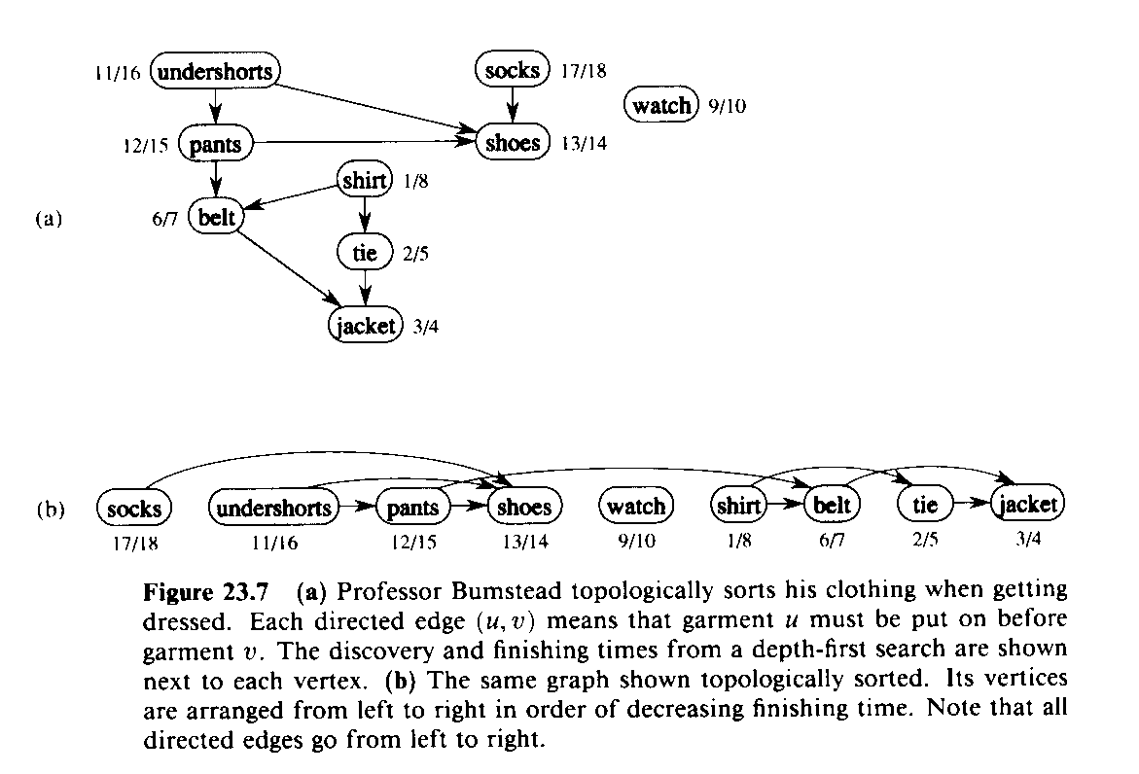
Elementary Graph Algorithms:
Topological Sort
  for Directed, Acyclic Graph (DAG)
  G=(V,E)
TOPOLOGICAL-SORT(G)
1 DFS(G) computes “finishing times” for each vertex
2 as each vertex is finished, insert it onto front of list
3 return list
  Produces linear ordering of vertices.
  For edge (u,v), u is ordered before v.
source: 91.503 textbook Cormen et al.

Slide 114
Topological Sort
The following algorithm topologically sorts a DAG:
TOPOLOGICAL-SORT(G)
  call DFS(G) to compute finishing times f[v] for each vertex v (this is equal to the order in which vertices change color from gray to black)
  as each vertex is finished (turns black), insert it onto the front of a linked list
  return the linked list of vertices

Slide 115
Example
A
D
For this DAG:
DFS produces this result:
  this contains 2 DFS trees
Vertices are blackened in the following order:
  C, B, F, A, D, E , G
B
G
F
C
E
A
D
T
C
C
T
T
B
F
T
G
T
F
C
C
E
C

Slide 116
Example
Vertices are added to front of a linked list in the blackening order.
Final result is shown below
Note that all tree edges and non-tree edges point to the right
T
C
T
T
C
T
G
E
D
C
A
B
C
F
T
C
F

Slide 117
Topological Sort
We can perform a topological sort in time Θ(V + E), since depth-first search takes Θ(V + E) time and it takes 0(1) time to insert each of the |V| vertices onto the front of the linked list.

Slide 118
Topological Sort
Theorem 23.11: TOPOLOGICAL-SORT(G) produces a topological sort of a directed acyclic graph G.
Proof: Suppose that DFS is run on a given dag G = (V, E) to determine finishing times for its vertices. It suffices to show that for any pair of distinct vertices u,v Î V, if there is an edge in G from u to v, then f[v] < f[u]. Consider any edge (u,v) explored by DFS(G). When this edge is explored, v cannot be gray, since then v would be an ancestor of u and (u,v) would be a back edge, contradicting Lemma 22.11. Therefore, v must be either white or black. If v is white, it becomes a descendant of u, and so f[v] < f[u]. If v is black, then f[v] < f[u] as well. Thus, for any edge (u,v) in the dag, we have f[v] < f[u], proving the theorem.

Slide 119
Chapter 23
Minimum Spanning Trees
Kruskal
Prim
[Source: Cormen et al. textbook except where noted]
Notes:
I joined the UMass Lowell Computer Science faculty this summer. This collection of slides is intended to familiarize the reader/viewer with my field of research (Computational Geometry), summarize my previous research results in this field and outline my plan for Computational Geometry research at UMass Lowell.

Slide 120
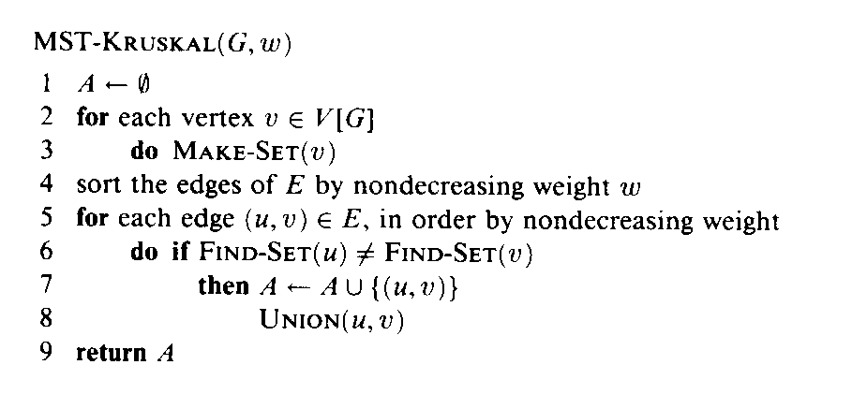
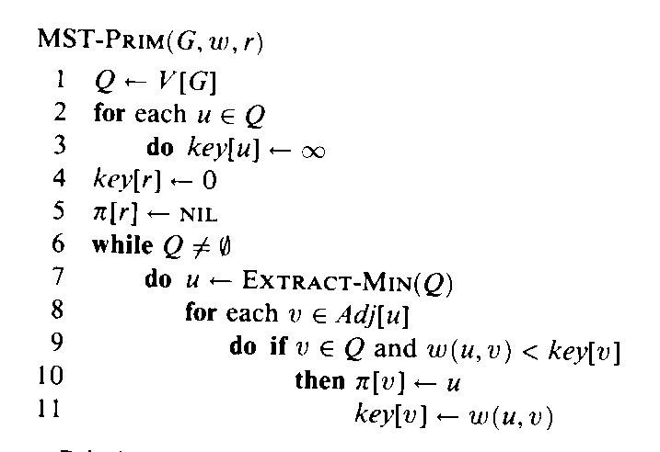
Minimum Spanning Tree:
Greedy Algorithms
Time: O(|E|lg|E|) given fast FIND-SET, UNION
Invariant: Minimum weight spanning forest
  Produces minimum weight tree of edges that includes every vertex.
A
2
4
B
Becomes single tree at end
3
G
5
6
Time: O(|E|lg|V|) = O(|E|lg|E|) slightly faster with fast priority queue
1
E
1
Invariant: Minimum weight tree
7
6
F
8
4
D
C
Spans all vertices at end
2
  for Undirected, Connected, Weighted Graph
  G=(V,E)
source: 91.503 textbook Cormen et al.

Slide 121
Minimum Spanning Trees
Review problem:
  For the undirected, weighted graph below, show 2 different Minimum Spanning Trees. Draw each using one of the 2 graph copies below. Thicken an edge to make it part of a spanning tree. What is the sum of the edge weights for each of your Minimum Spanning Trees?
A
2
4
B
3
G
5
6
1
E
1
7
6
F
8
4
D
C
2

Slide 122
Chapter 24
Shortest Paths
Dijkstra
[Source: Cormen et al. textbook except where noted]
Notes:
I joined the UMass Lowell Computer Science faculty this summer. This collection of slides is intended to familiarize the reader/viewer with my field of research (Computational Geometry), summarize my previous research results in this field and outline my plan for Computational Geometry research at UMass Lowell.

Slide 123
BFS as a Basis for Shortest Path Algorithms
for unweighted, undirected graph G=(V,E)
Time: O(|V| + |E|) adj list
O(|V|²) adj matrix
BFS
Problem: Given 2 vertices u, v, find the shortest path in G from u to v.
Source/Sink Shortest Path
Solution: BFS starting at u. Stop at v.
Problem: Given a vertex u, find the shortest path in G from u to each vertex.
Single-Source Shortest Paths
Solution: BFS starting at u. Full BFS tree.
Problem: Find the shortest path in G from each vertex u to each vertex v.
All-Pairs Shortest Paths
Solution: For each u: BFS starting at u; full BFS tree.
Time: O(|V|(|V| + |E|)) adj list
O(|V|³) adj matrix
source: based on Sedgewick, Graph Algorithms

Slide 124
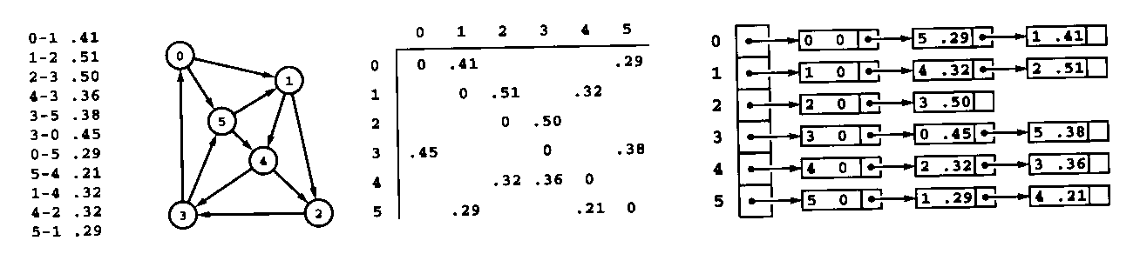
Shortest Path Applications
for weighted, directed graph G=(V,E)
Weight ~ Cost ~ Distance
Road maps
Airline routes
Telecommunications network routing
VLSI design routing
source: based on Sedgewick, Graph Algorithms

Slide 125
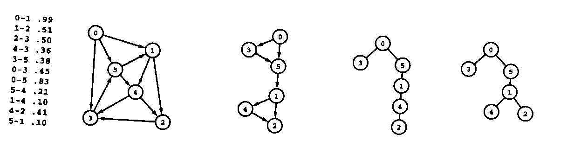
Shortest Path Trees
Shortest Path Tree gives shortest path from root to each other vertex
source: Sedgewick, Graph Algorithms

Slide 126
Shortest Path Principles: Relaxation
“Relax” a constraint to try to improve solution
“Rubber band” analogy [Sedgewick]
Relaxation of an Edge (u,v):
  test if shortest path to v [found so far] can be improved by going through u
A
2
B
4
3
G
5
6
1
E
1
7
6
F
8
D
4
C
2

Slide 127
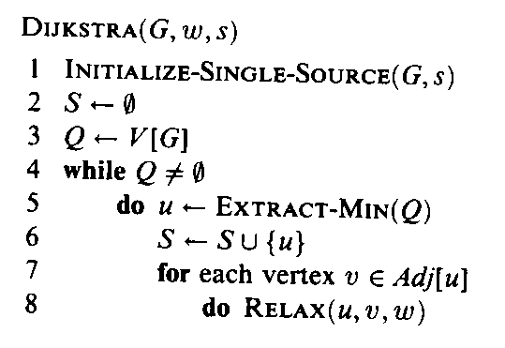
Single Source Shortest Paths
Dijkstra’s Algorithm
for (nonnegative) weighted, directed graph G=(V,E)
source: 91.503 textbook Cormen et al.

Slide 128
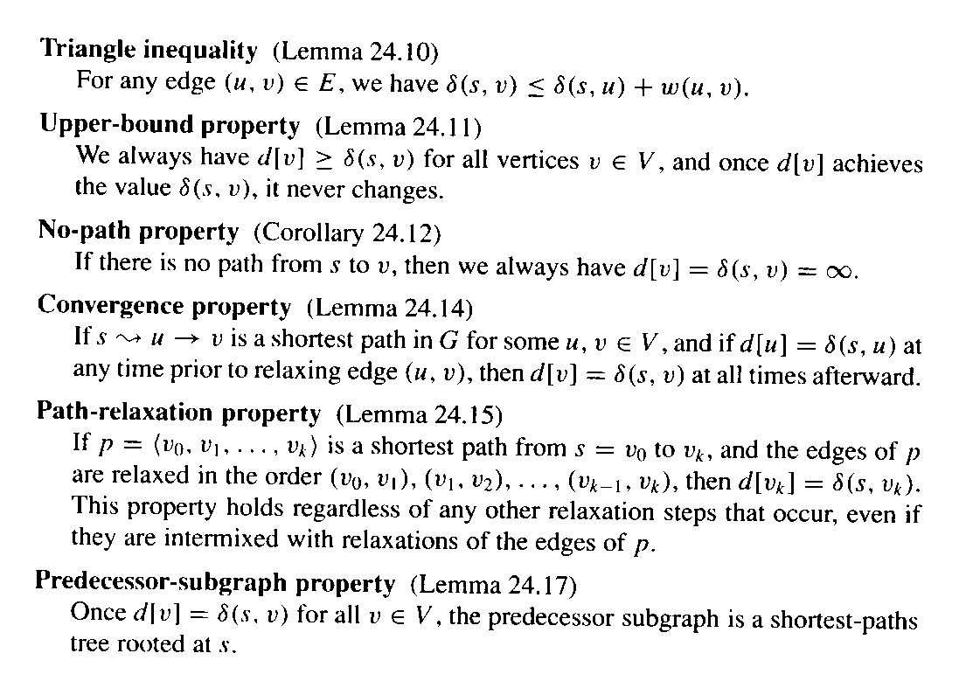
Single Source Shortest Paths
Dijkstra’s Algorithm
for (nonnegative) weighted, directed graph G=(V,E)
See separate ShortestPath 91.404 slide show
A
2
B
4
3
G
5
6
1
E
1
7
6
F
8
D
4
C
2
source: 91.503 textbook Cormen et al.

Slide 129
Single Source Shortest Paths
Dijkstra’s Algorithm
Review problem:
    For the directed, weighted graph below, find the shortest path that begins at vertex A and ends at vertex F. List the vertices in the order that they appear on that path. What is the sum of the edge weights of that path?
A
2
B
4
3
G
5
6
1
E
1
7
6
F
8
D
4
C
2
Why can’t Dijkstra’s algorithm handle negative-weight edges?

Slide 130
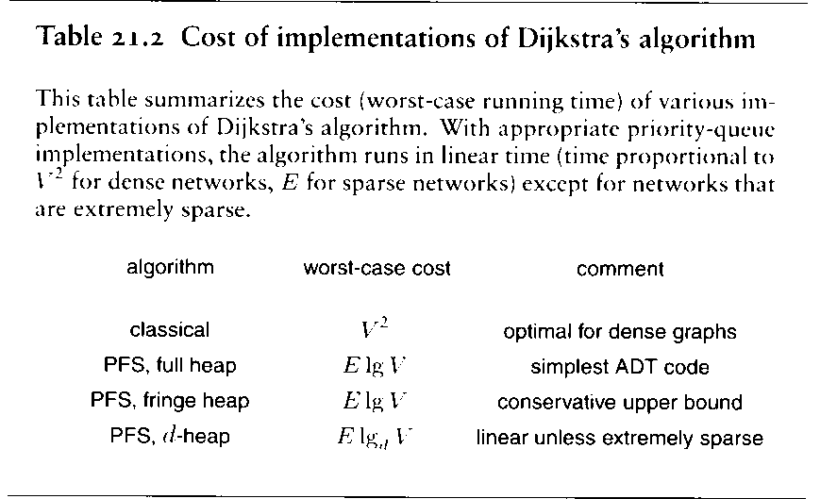
Single Source Shortest Paths
Dijkstra’s Algorithm
for (nonnegative) weighted, directed graph G=(V,E)
source: Sedgewick, Graph Algorithms

Slide 131
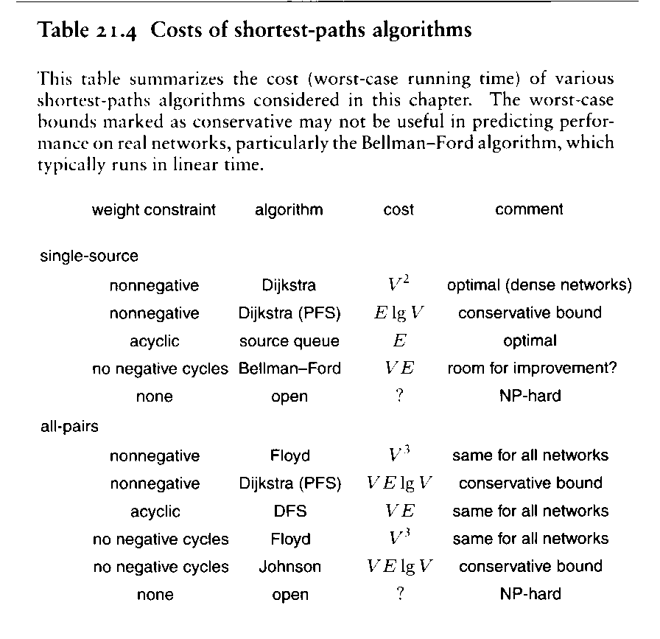
Shortest Path Algorithms
source: Sedgewick, Graph Algorithms

